Slide 1
Real-time Lighting for Mixed Reality Applications
Niko Kirste
Faculty of Computer Science
Final Presentation, INF-PM-FPA
Dresden, 16.10.2024

Slide 2


Slide 3
Table of Contents
Motivation
Research Question
Existing Methods & Related Work
Implementation Process
Results
Future Work
Conclusion

Slide 4
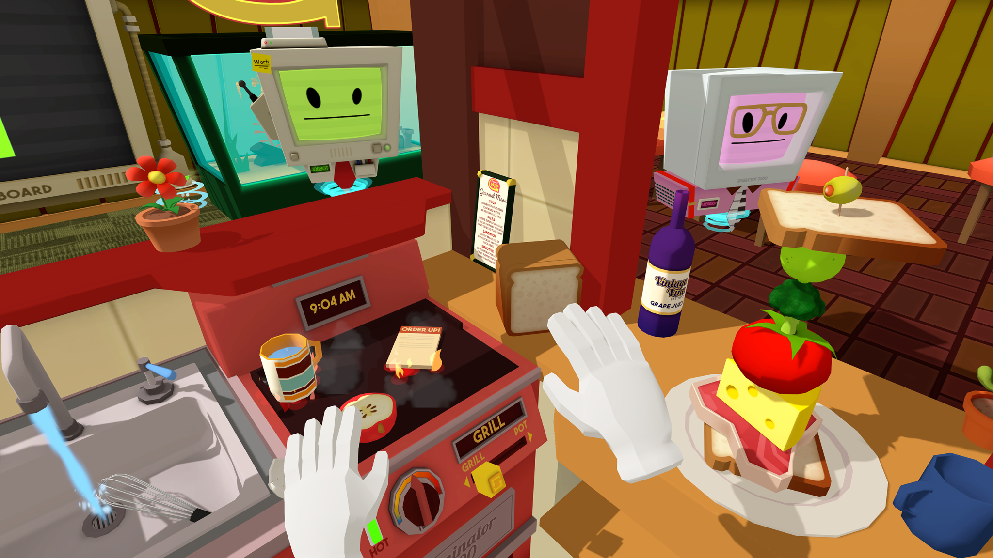
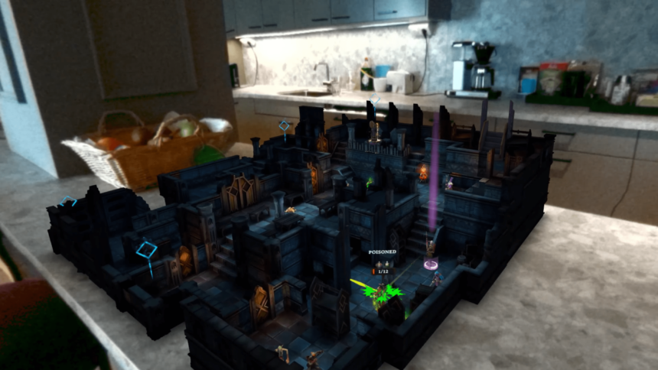
Motivation
Lighting in traditional VR Applications:
Closed environment
No interaction with real world lighting
→ static precomputed lighting
→ low overhead
Lighting in MR Applications:
Ongoing interaction with real world lighting
Constantly changing
Immersion depends on correct lighting
→ need to adapt

Slide 5
Research Question
How can we get lighting information from the physical world to the MR application in real-time?
Accurate colors
Low overhead on the HMD
Preferably multi-user enabled

Slide 6
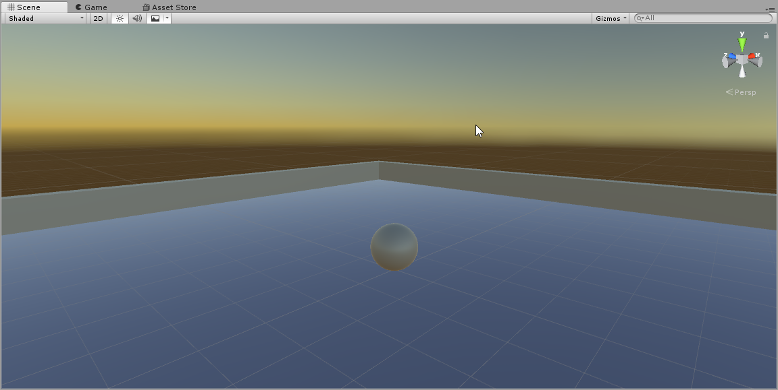
Existing Methods
Skybox:
Static or dynamic 360° texture
Projected into infinity
Contributes to single ambient light probe
→ no spatial gradient
→ same lighting for every object

Slide 7
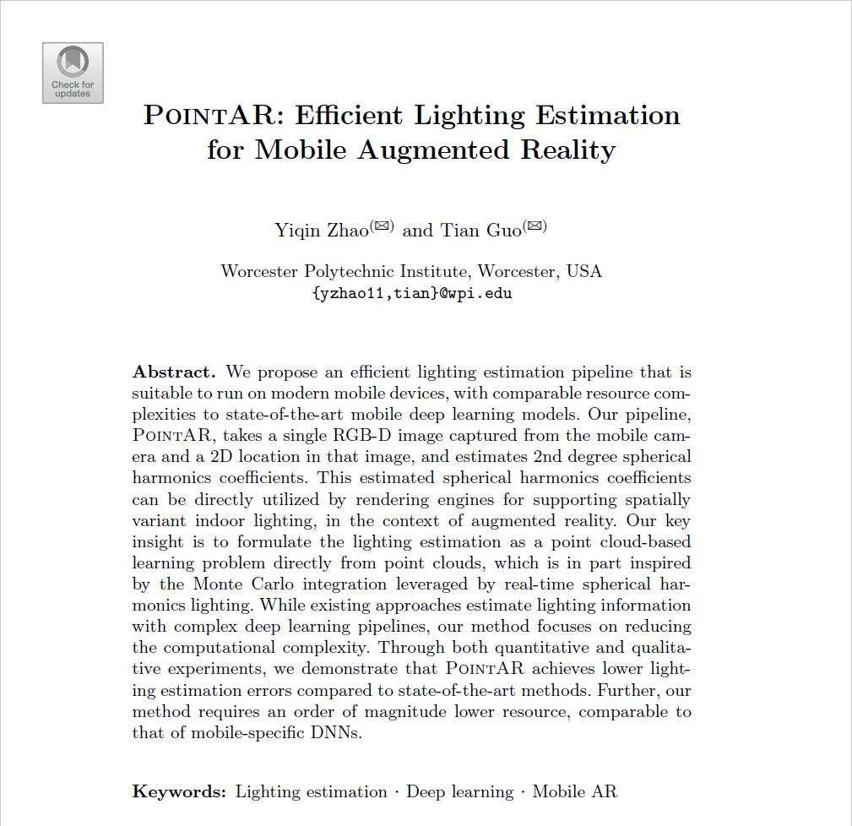
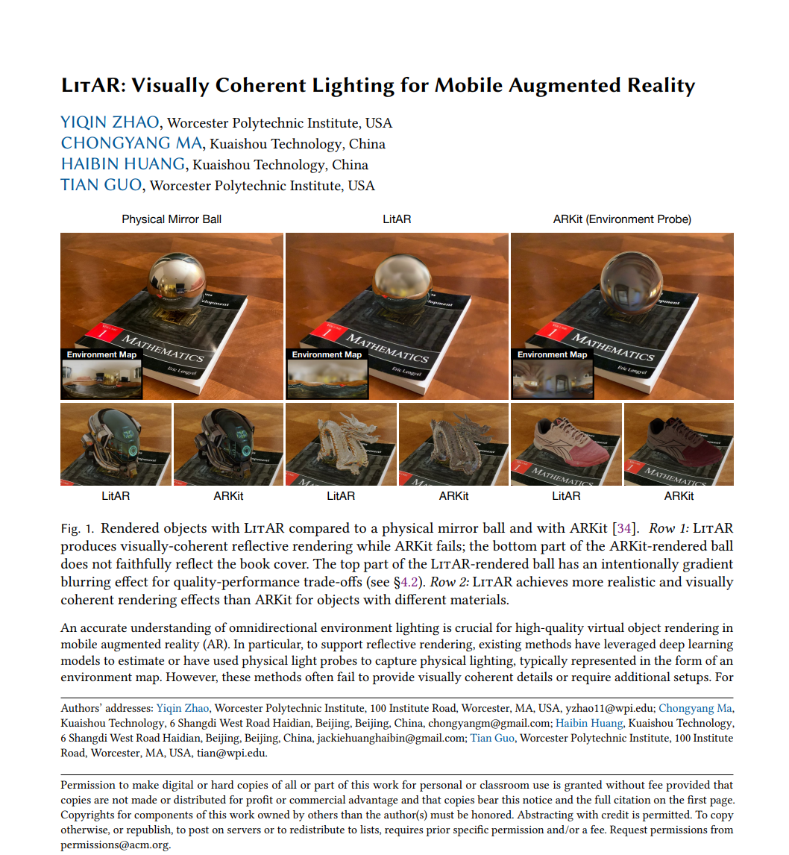
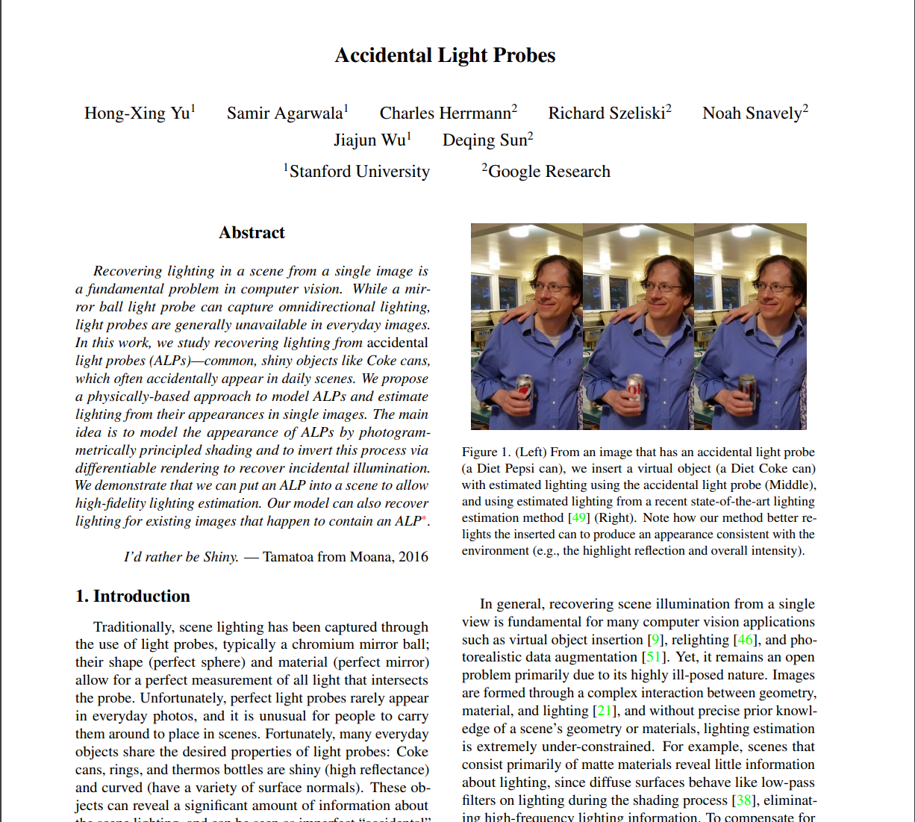
Related Work
Light Probe generation

Slide 8
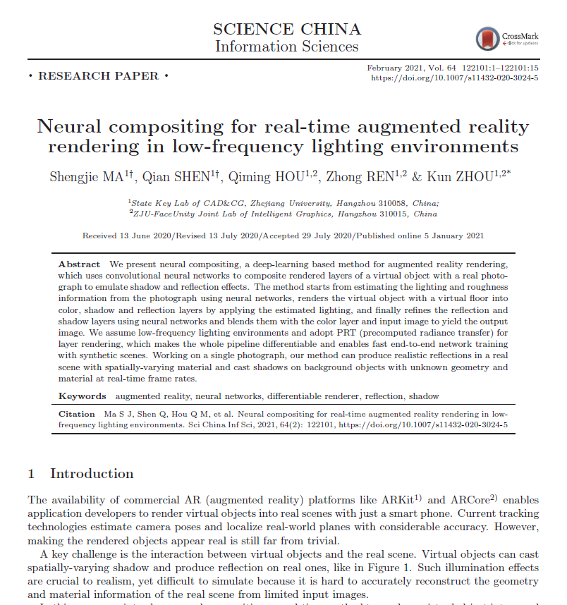
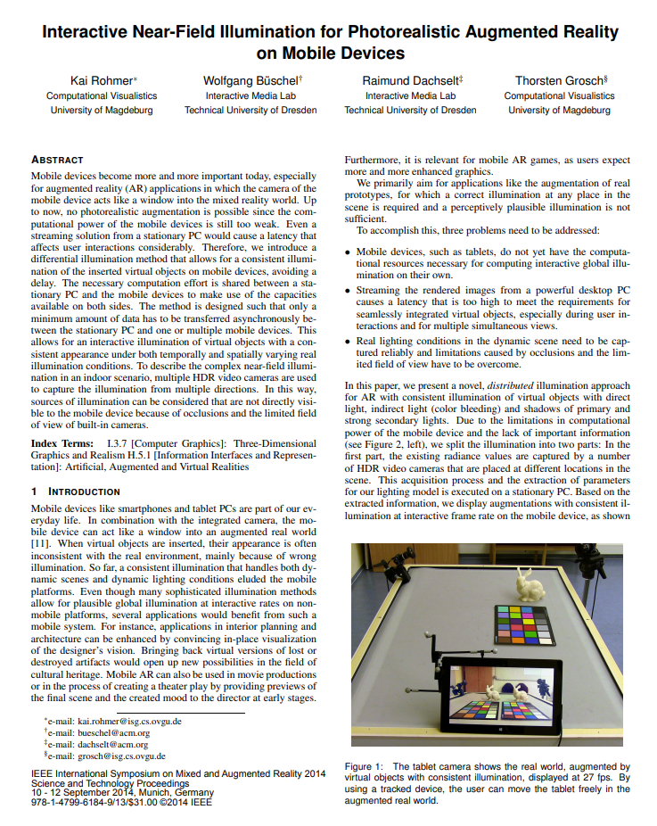
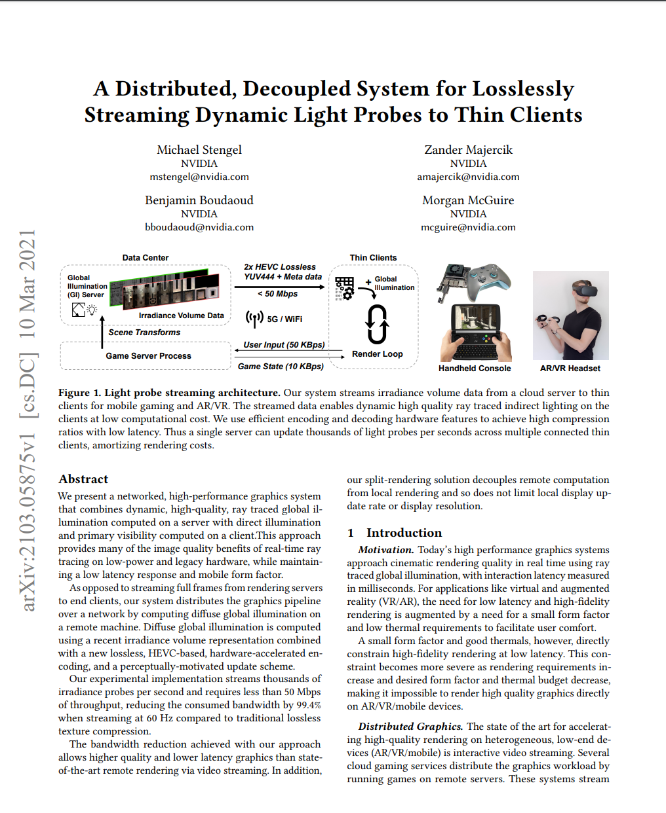
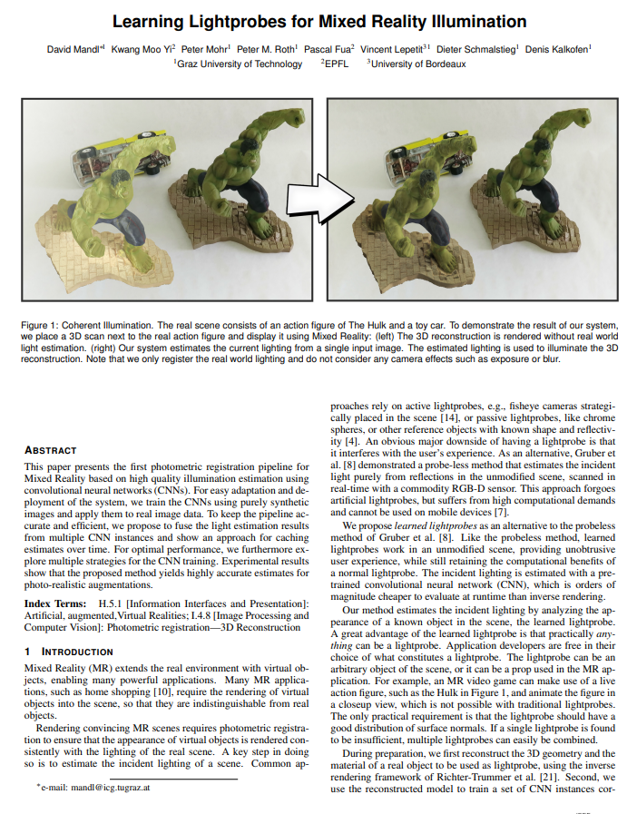
Related Work
Neural Network based Lighting
Distributed Lighting

Slide 9
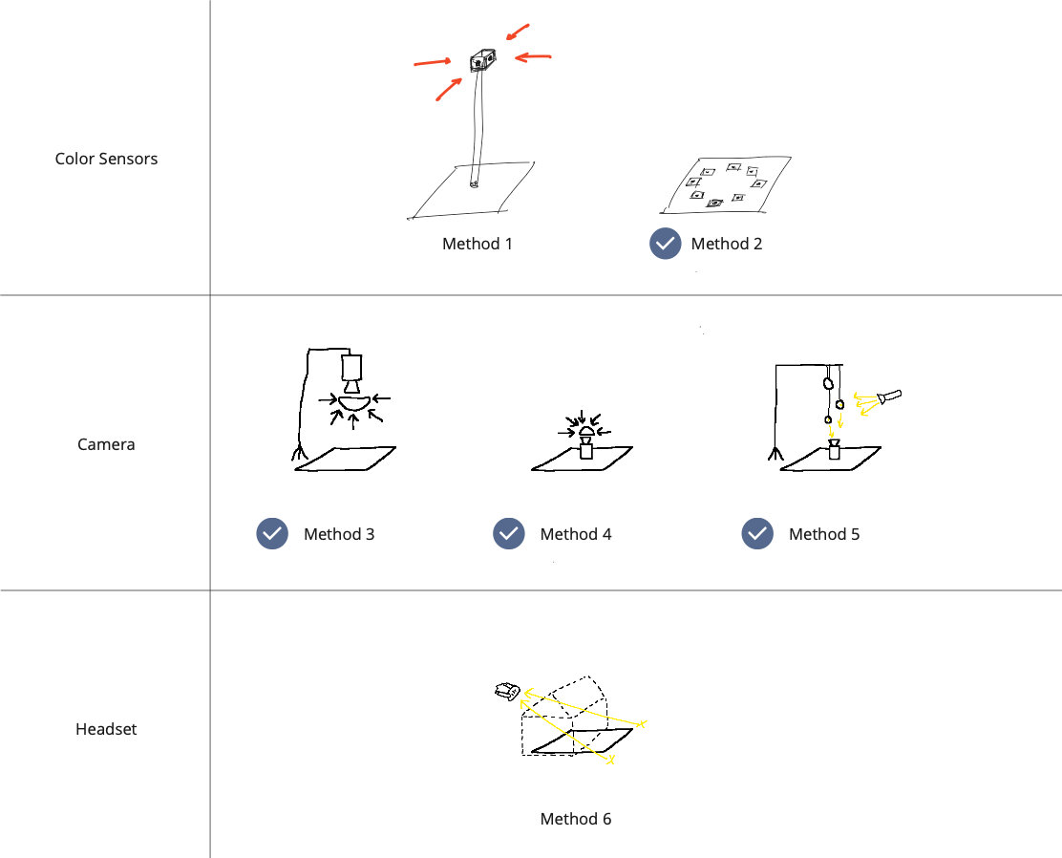
Initial Ideas
Come up with different methods of capturing lighting information
Implement and compare some methods
Feasibility
Visual Appearance
Cost
Complexity
→ Focusing on small scale / local methods for single objects

Slide 10
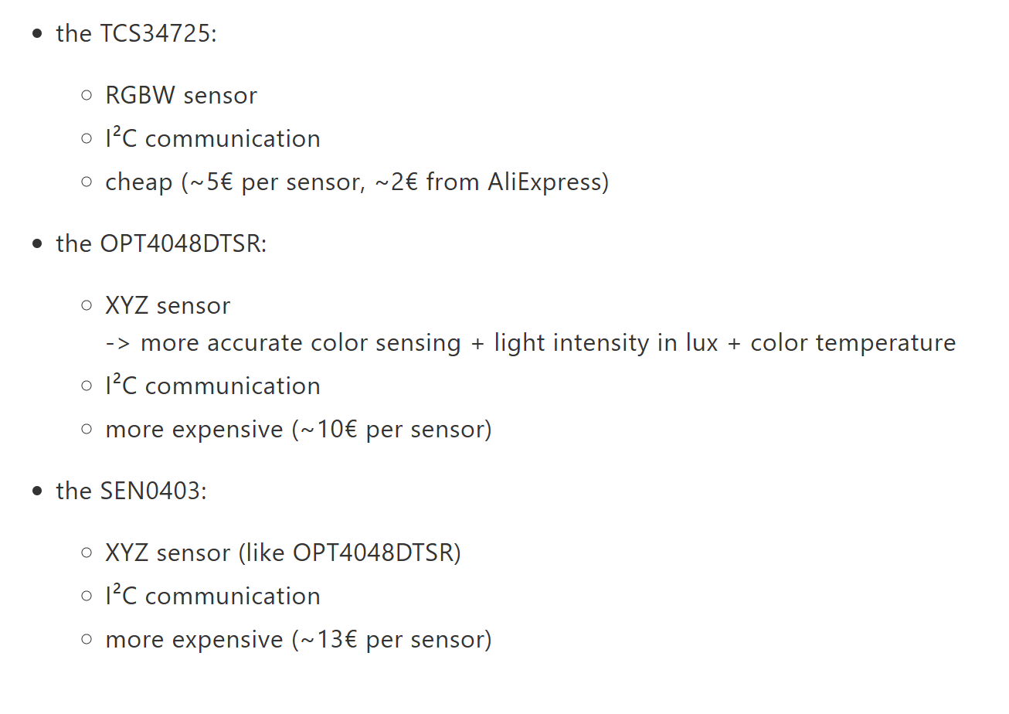
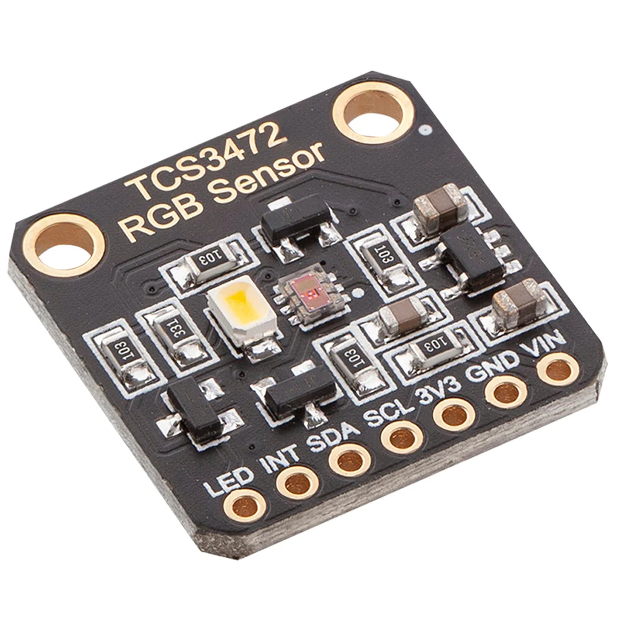

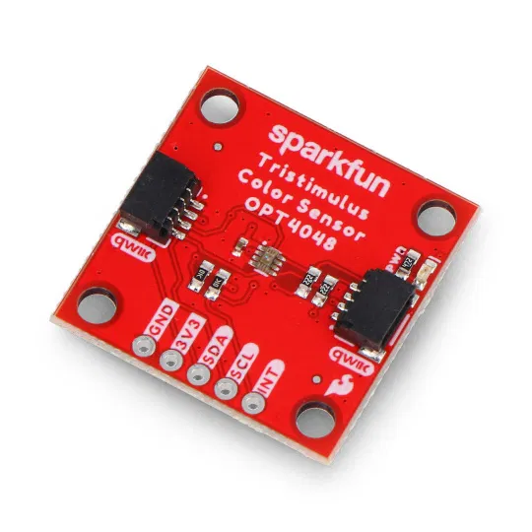
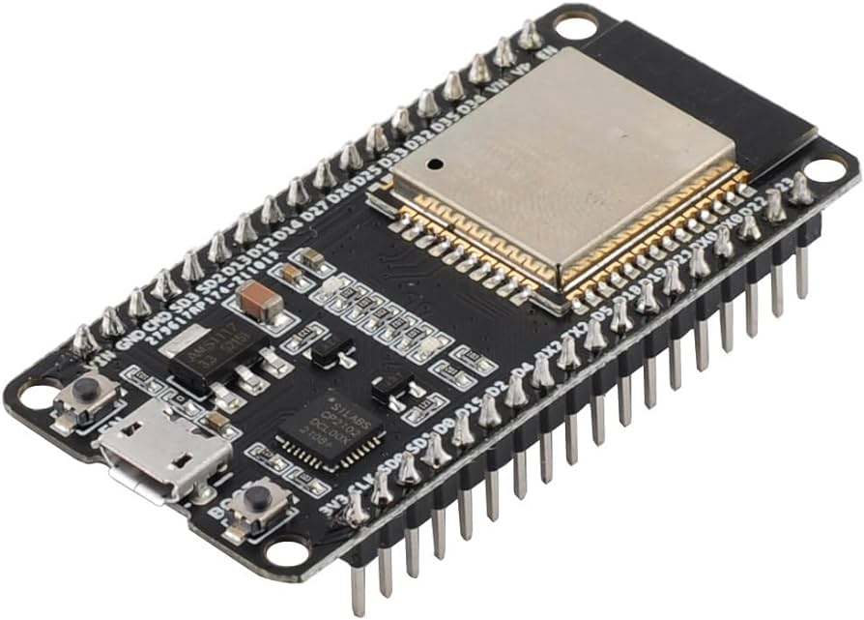
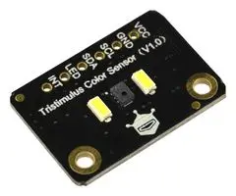
Color Sensor Methods
Hardware:
I²C

Slide 11
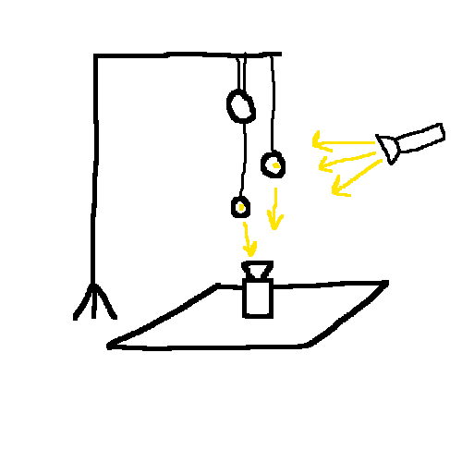
Single Camera, multiple Spheres
Calculate 3D position of light source
Create virtual light with same properties at same position
Affordable + Precise
Standard camera / smartphone
Some mirror spheres (e.g. christmas ornaments)

Slide 12
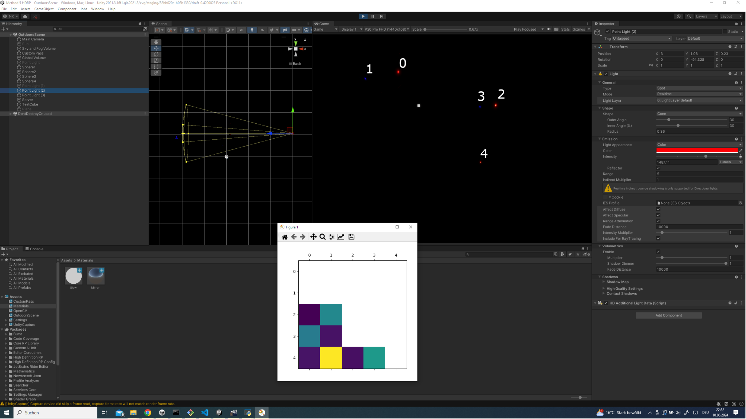

Slide 13
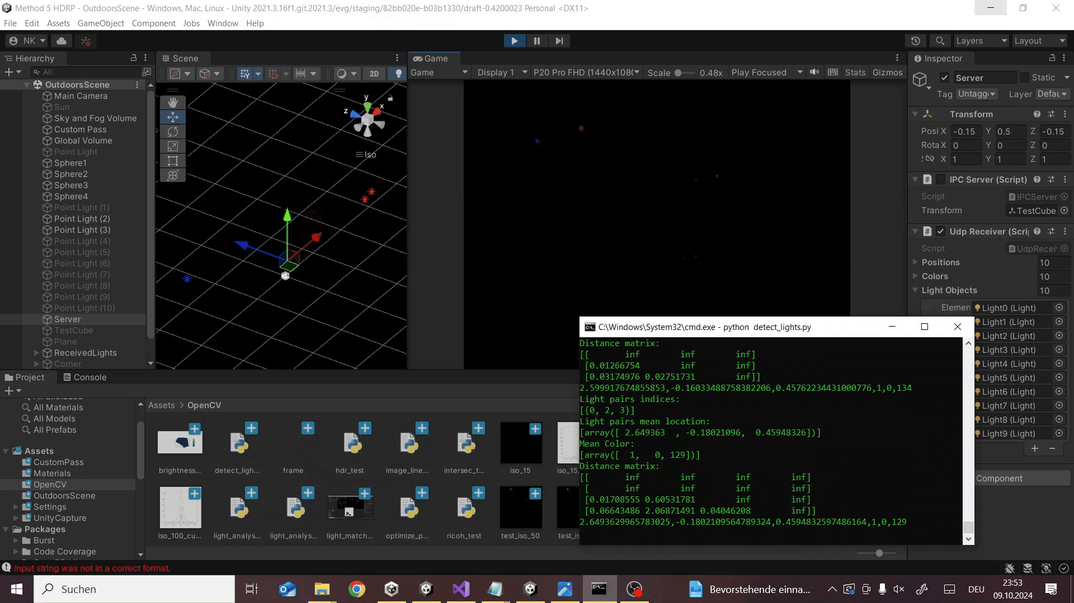

Slide 14
Improved Idea
Use 360° camera instead of fish eye lens
Use model of the room to project image onto
Use emissive material to cast light into the scene
Use light probes to light virtual objects

Slide 15
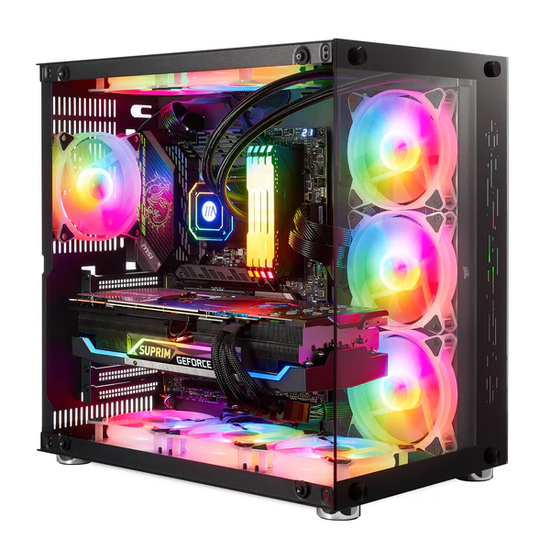
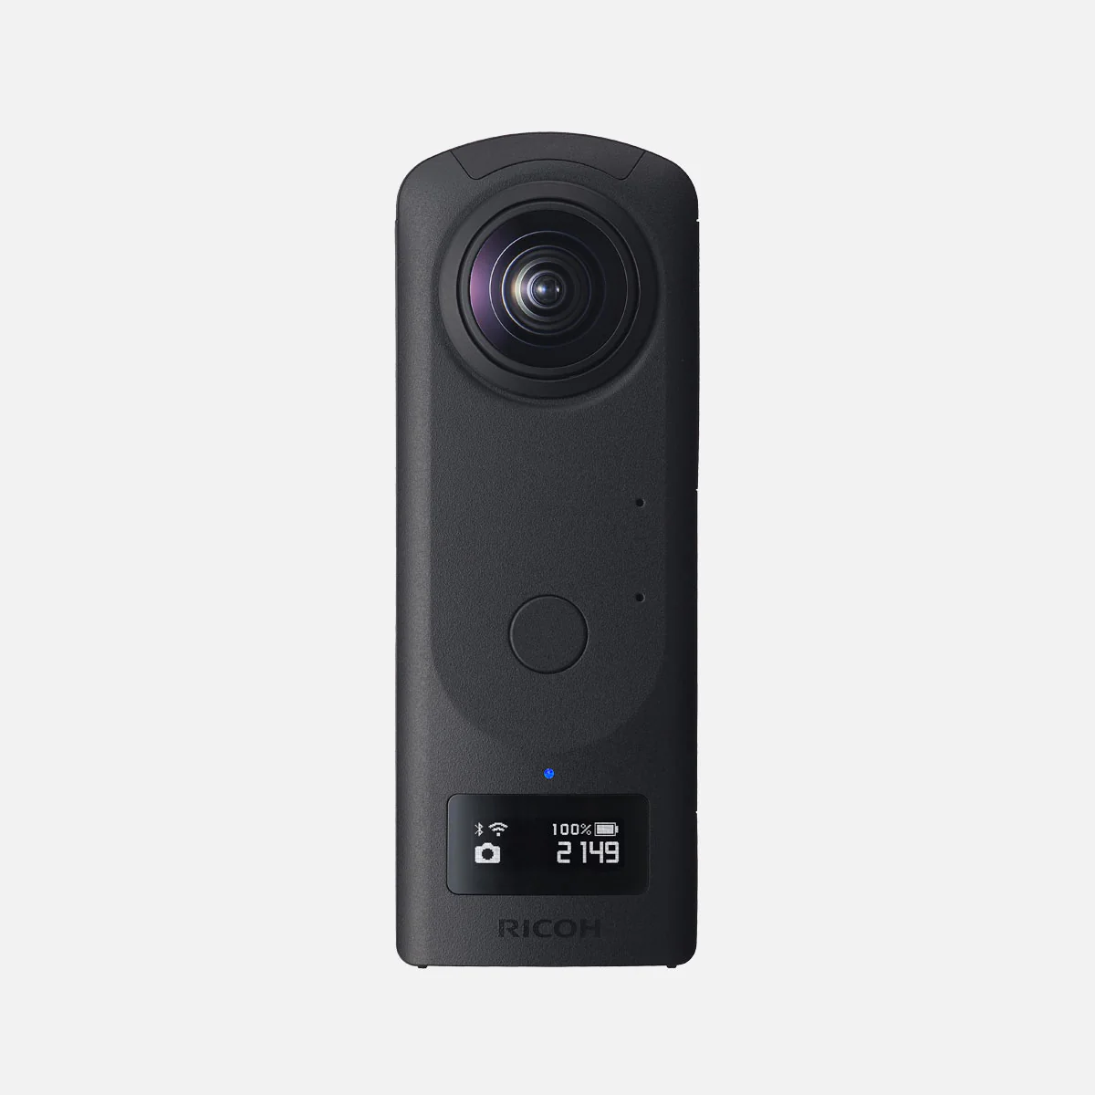
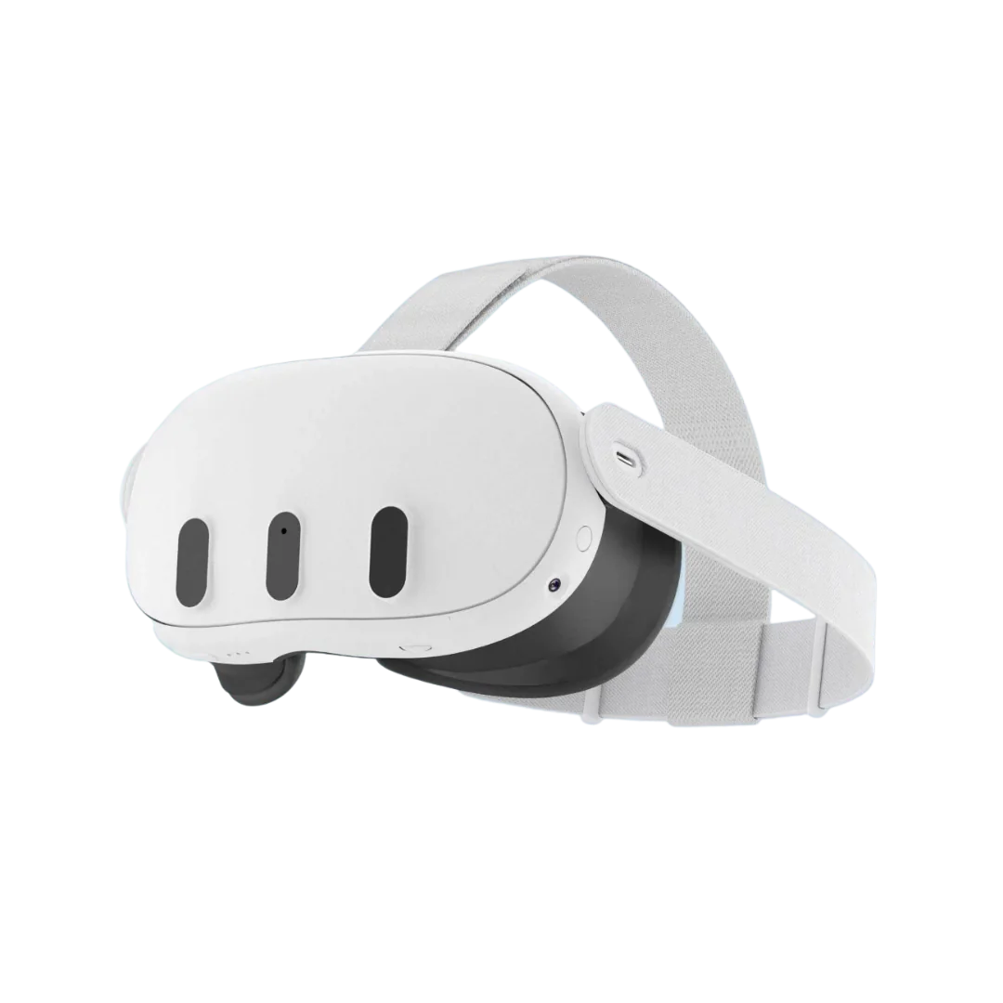
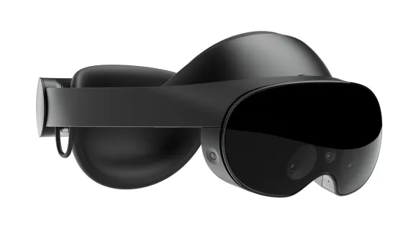
System Architecture
1. Capture Environment
2. Project onto Walls
3. Calculate Light Probes
5. Light Virtual Objects
4. Transmit Light Probes

Slide 16
Key Features
2. Project onto Walls
2. Project onto Walls
3. Calculate Light Probes
3. Calculate Light Probes
Model based Lighting using emissive Materials
Model based Lighting using emissive Materials
2. Streaming of Light Probes to multiple mobile Clients
2. Streaming of Light Probes to multiple mobile Clients
4. Transmit Light Probes
4. Transmit Light Probes

Slide 17
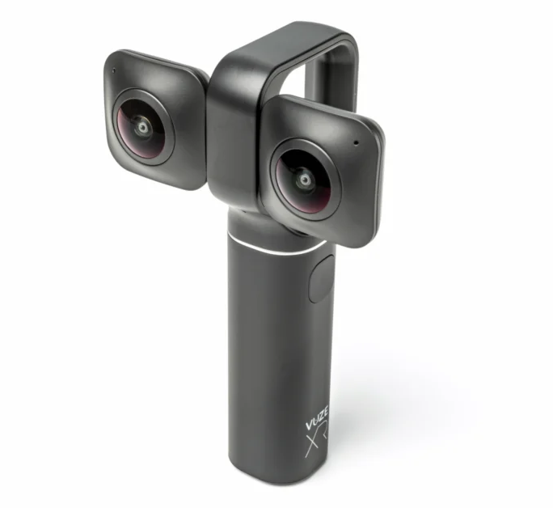
1. Capture the Environment
 | Ricoh Theta Z1 | Vuze XR
Lenses | 2x 180° x 180° | 2x 180° x 180°
Video Resolution | Up to 4K @ 30FPS | Up to 5.7K @ 30FPS
HDR support | For photos | None
Live Streaming | Over USB or per App | Per App
Software Availability | Over their Website | Discontinued

Slide 18



1. Capture the Environment
Ricoh Theta Z1 | Ricoh UVC Driver | OBS | Unity Project
Captures Video | Enables Live Streaming | Virtual Webcam to convert Image format | Webcam to RenderTexture

Slide 19
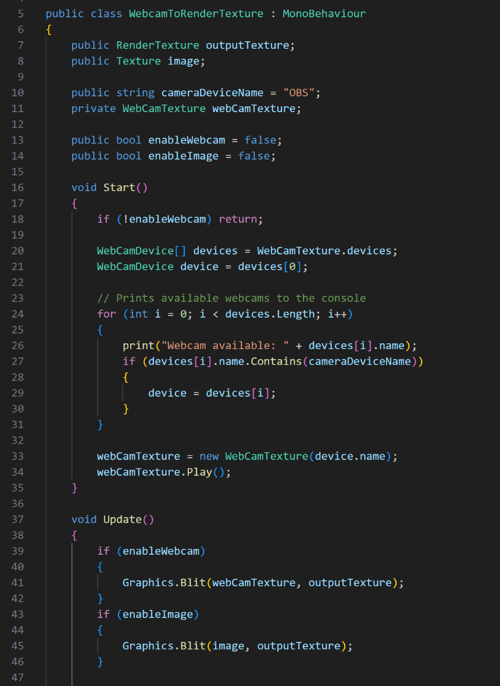
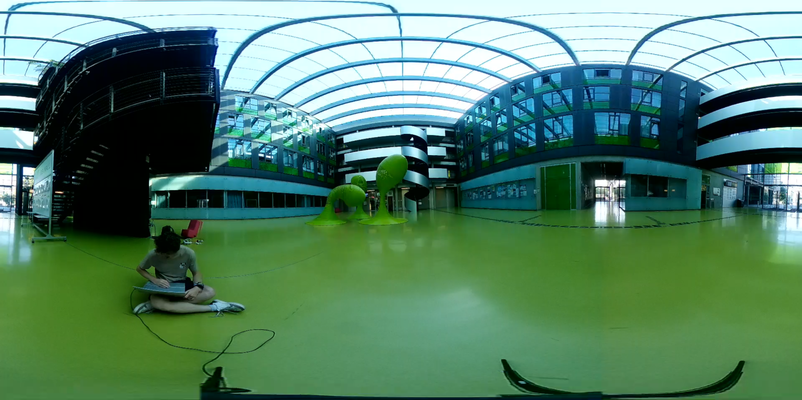
1. Capture the Environment
Selectable webcam device
Use static images for testing

Slide 20
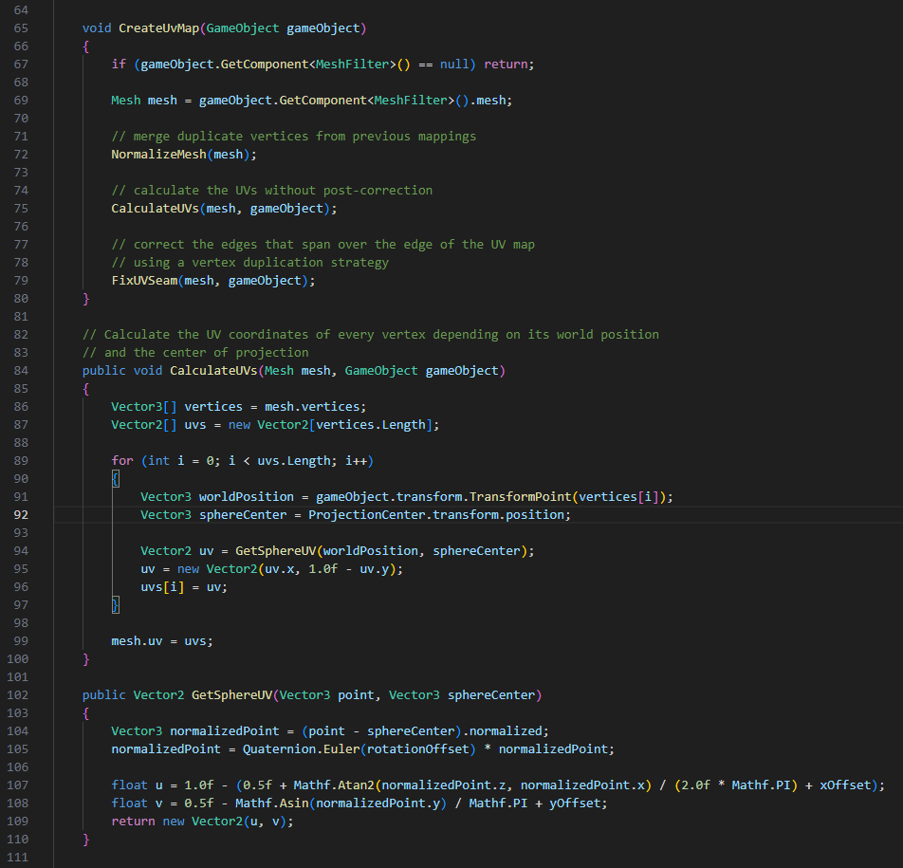
2. Projection onto Walls
UV-Mapping

Slide 21
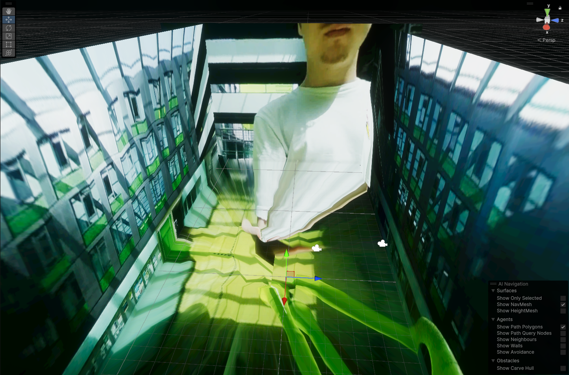
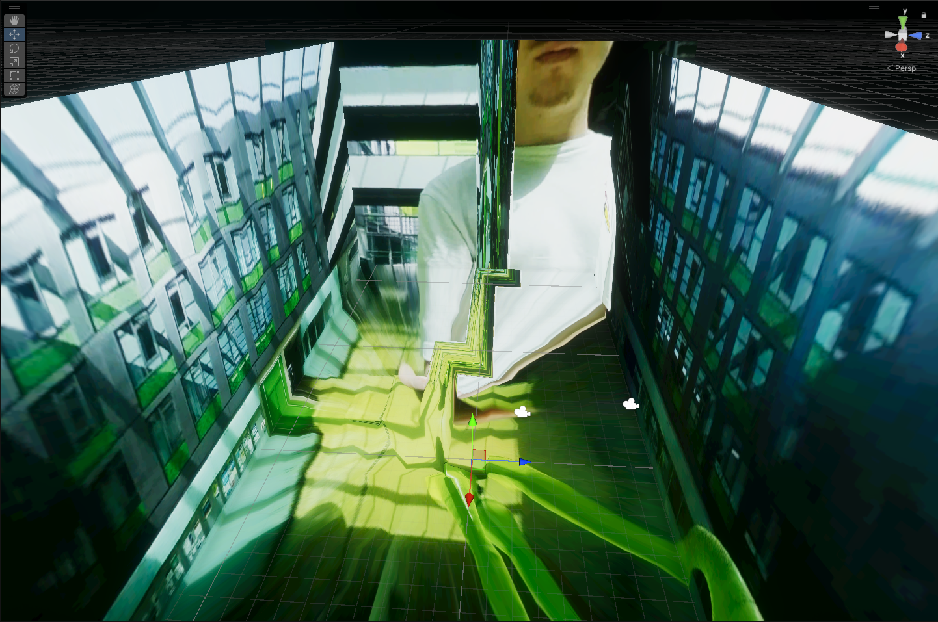
Problems
Interpolation Error
UV Seam

Slide 22
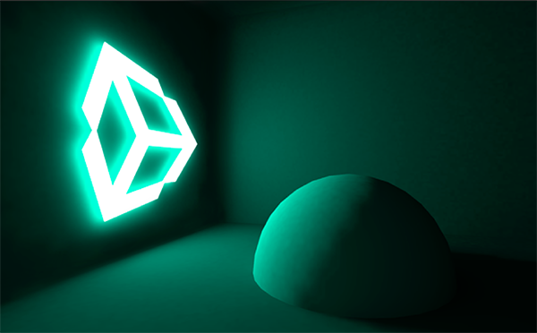
3. Calculating Light Probes
Realtime Global Illumination
Light that changes at runtime (not baked)
Direct light (Light Source → Object → Sensor)
Indirect Light (multiple bounces; different light sources like emissive materials)
Using Enlighten middleware

Slide 23
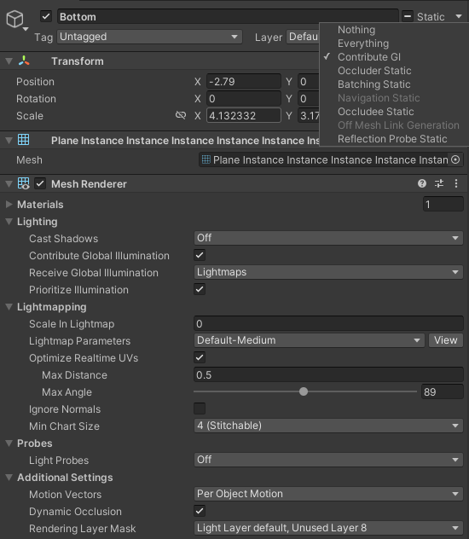
3. Calculating Light Probes using Realtime Global Illumination
Settings of the environment model
Mesh is included in GI calculations
Emission lightmap is needed to emit light
Mesh will always be included in GI calculations
Static objects would receive lighting from other emissive objects
0 means not lightmapped but still contributes to other renderers
Default-Medium for better quality
Default-VeryLowResolution for higher FPS

Slide 24
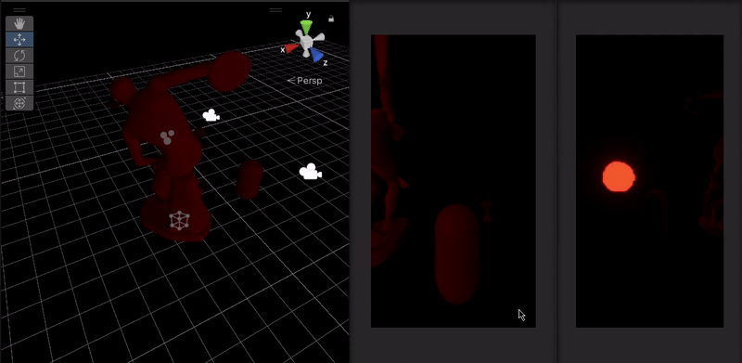
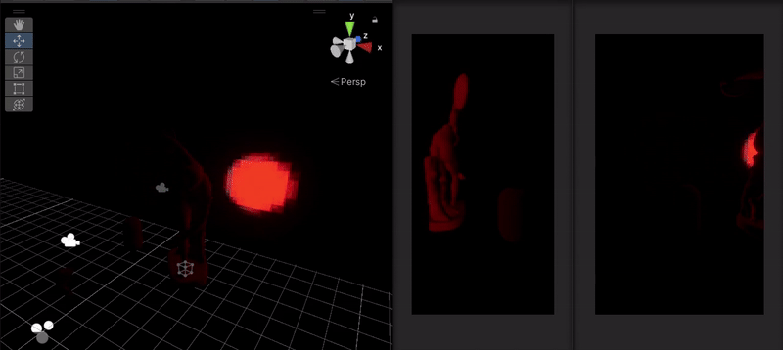
Lightmap Parameters
Default-VeryLowResolution
Default-Medium

Slide 25
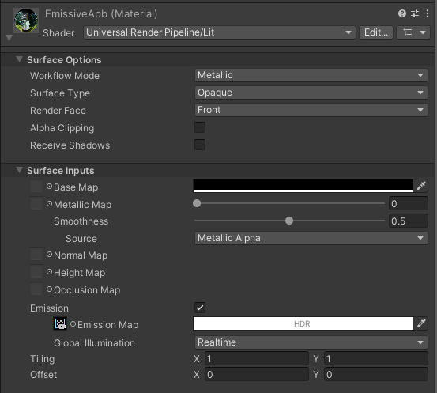
3. Calculating Light Probes using Realtime Global Illumination
Settings of the emissive material
Default shader supports emissive settings
EmissionMap is set to the webcam RenderTexture
Update GI at runtime

Slide 26
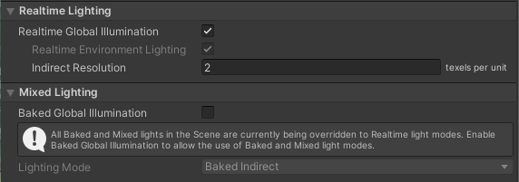
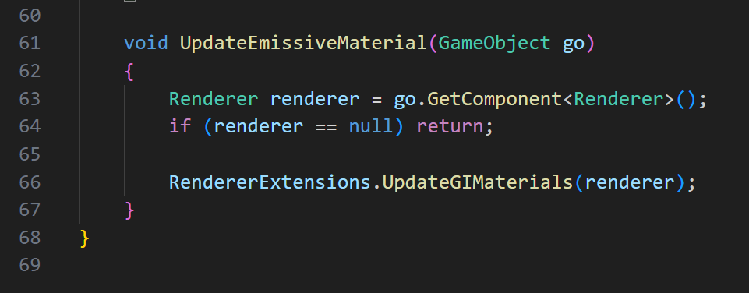
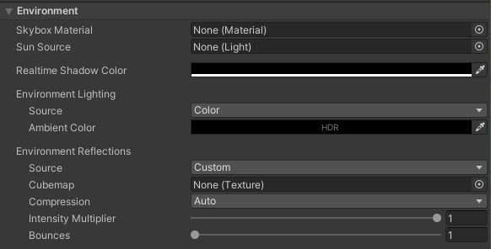
3. Calculating Light Probes using Realtime Global Illumination
Lighting Settings
Trigger GI Update
Light Probes need to be baked into the scene with ‘Generate Lighting’ button

Slide 27
4. Transmit Light Probes
Transport Protocol
TCP | UDP
Reliable transmission | Can be unreliable
Overhead through ACKs | No Overhead
No Broadcast | Broadcast to multiple devices
perfect for realtime applications!

Slide 28
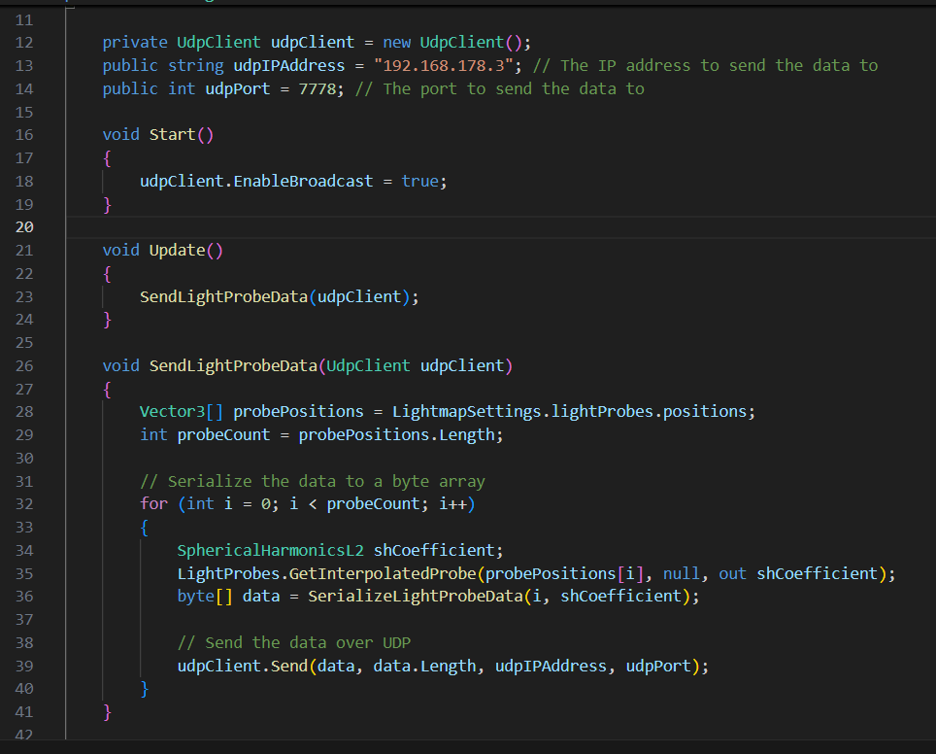
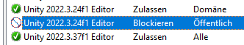
4. Transmit Light Probes
Disable Firewall for Unity!

Slide 29
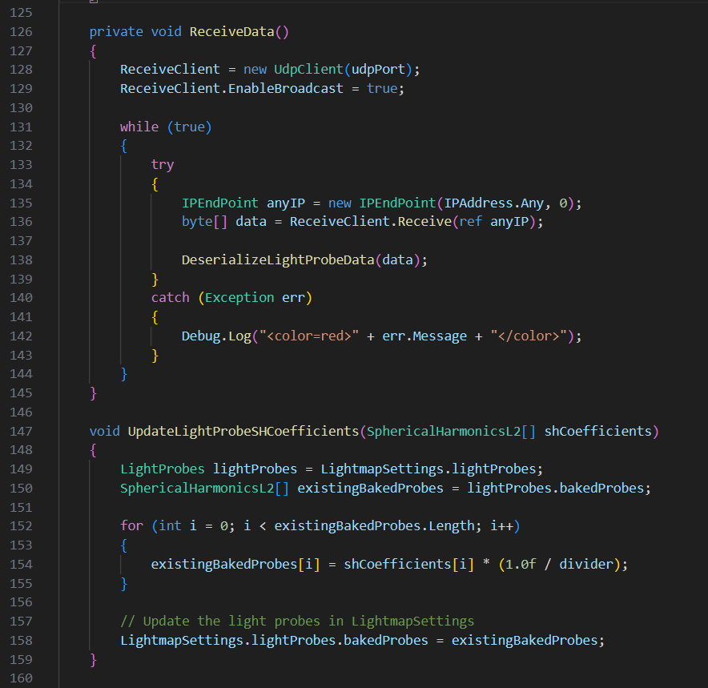
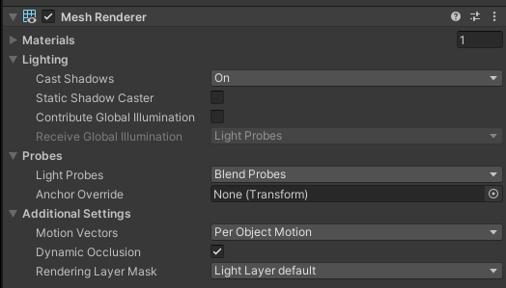
5. Light virtual Objects

Slide 30
Further Challenges
Consistent Camera Positioning
Place the Camera in the room
Guess the position in the virtual model
Project camera stream onto virtual model
Repeat from 2. until properly aligned
→ take advantage of ViewR’s calibration
Place a small virtual indicator at the position of the camera
Place the camera at the position of the indicator using passthrough
4 DoF
→ cumbersome process
1 DoF

Slide 31
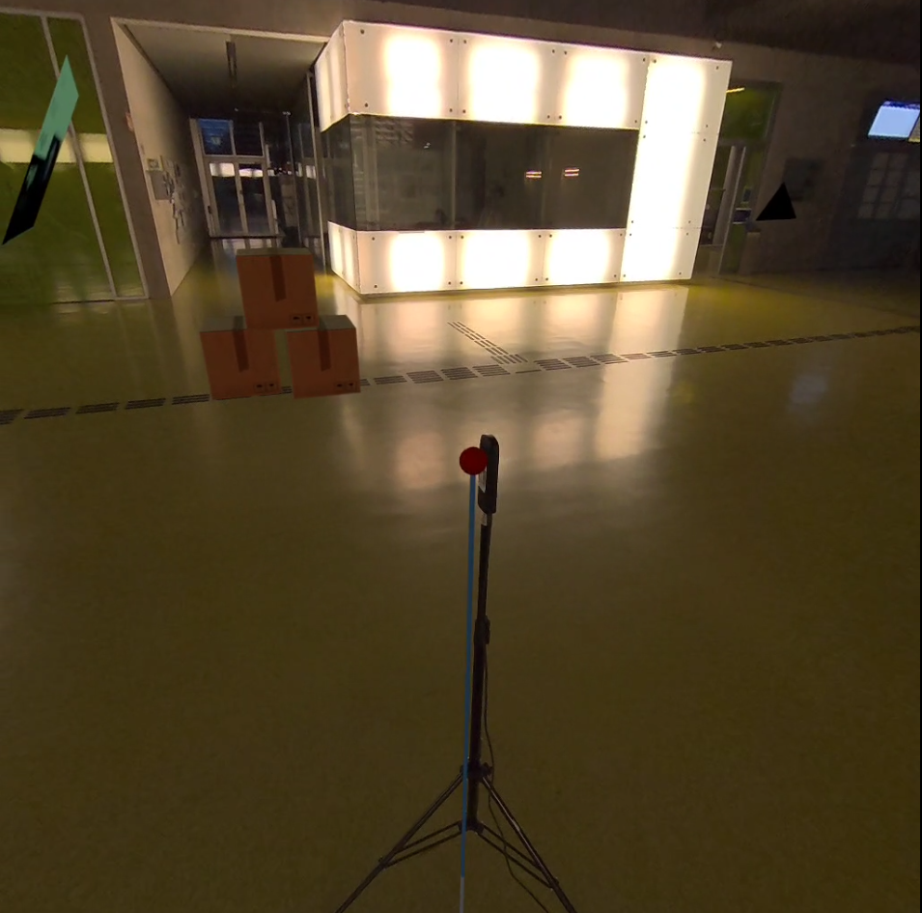
Camera Calibration

Slide 32
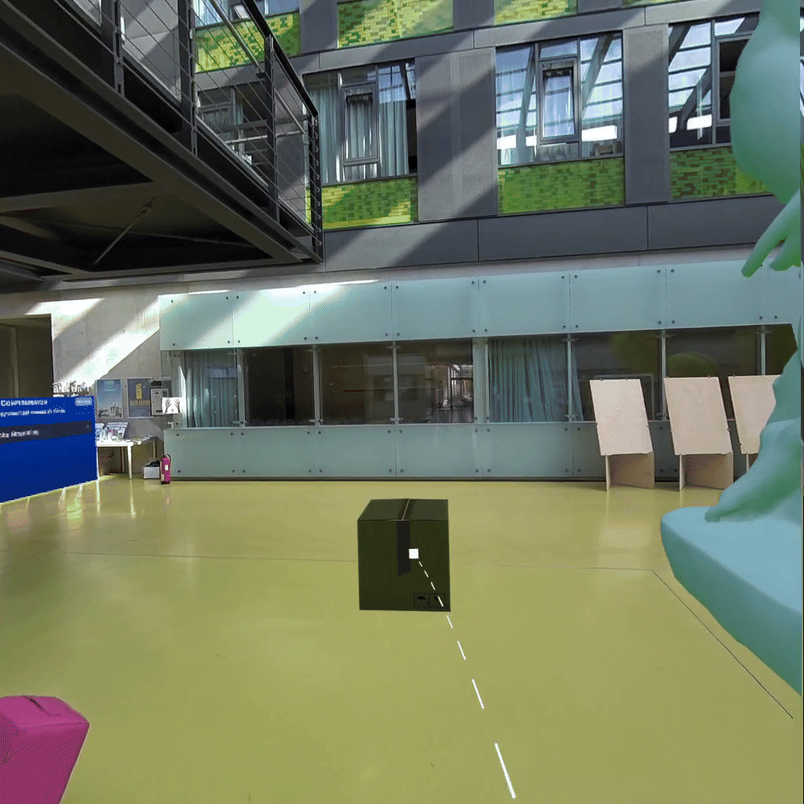
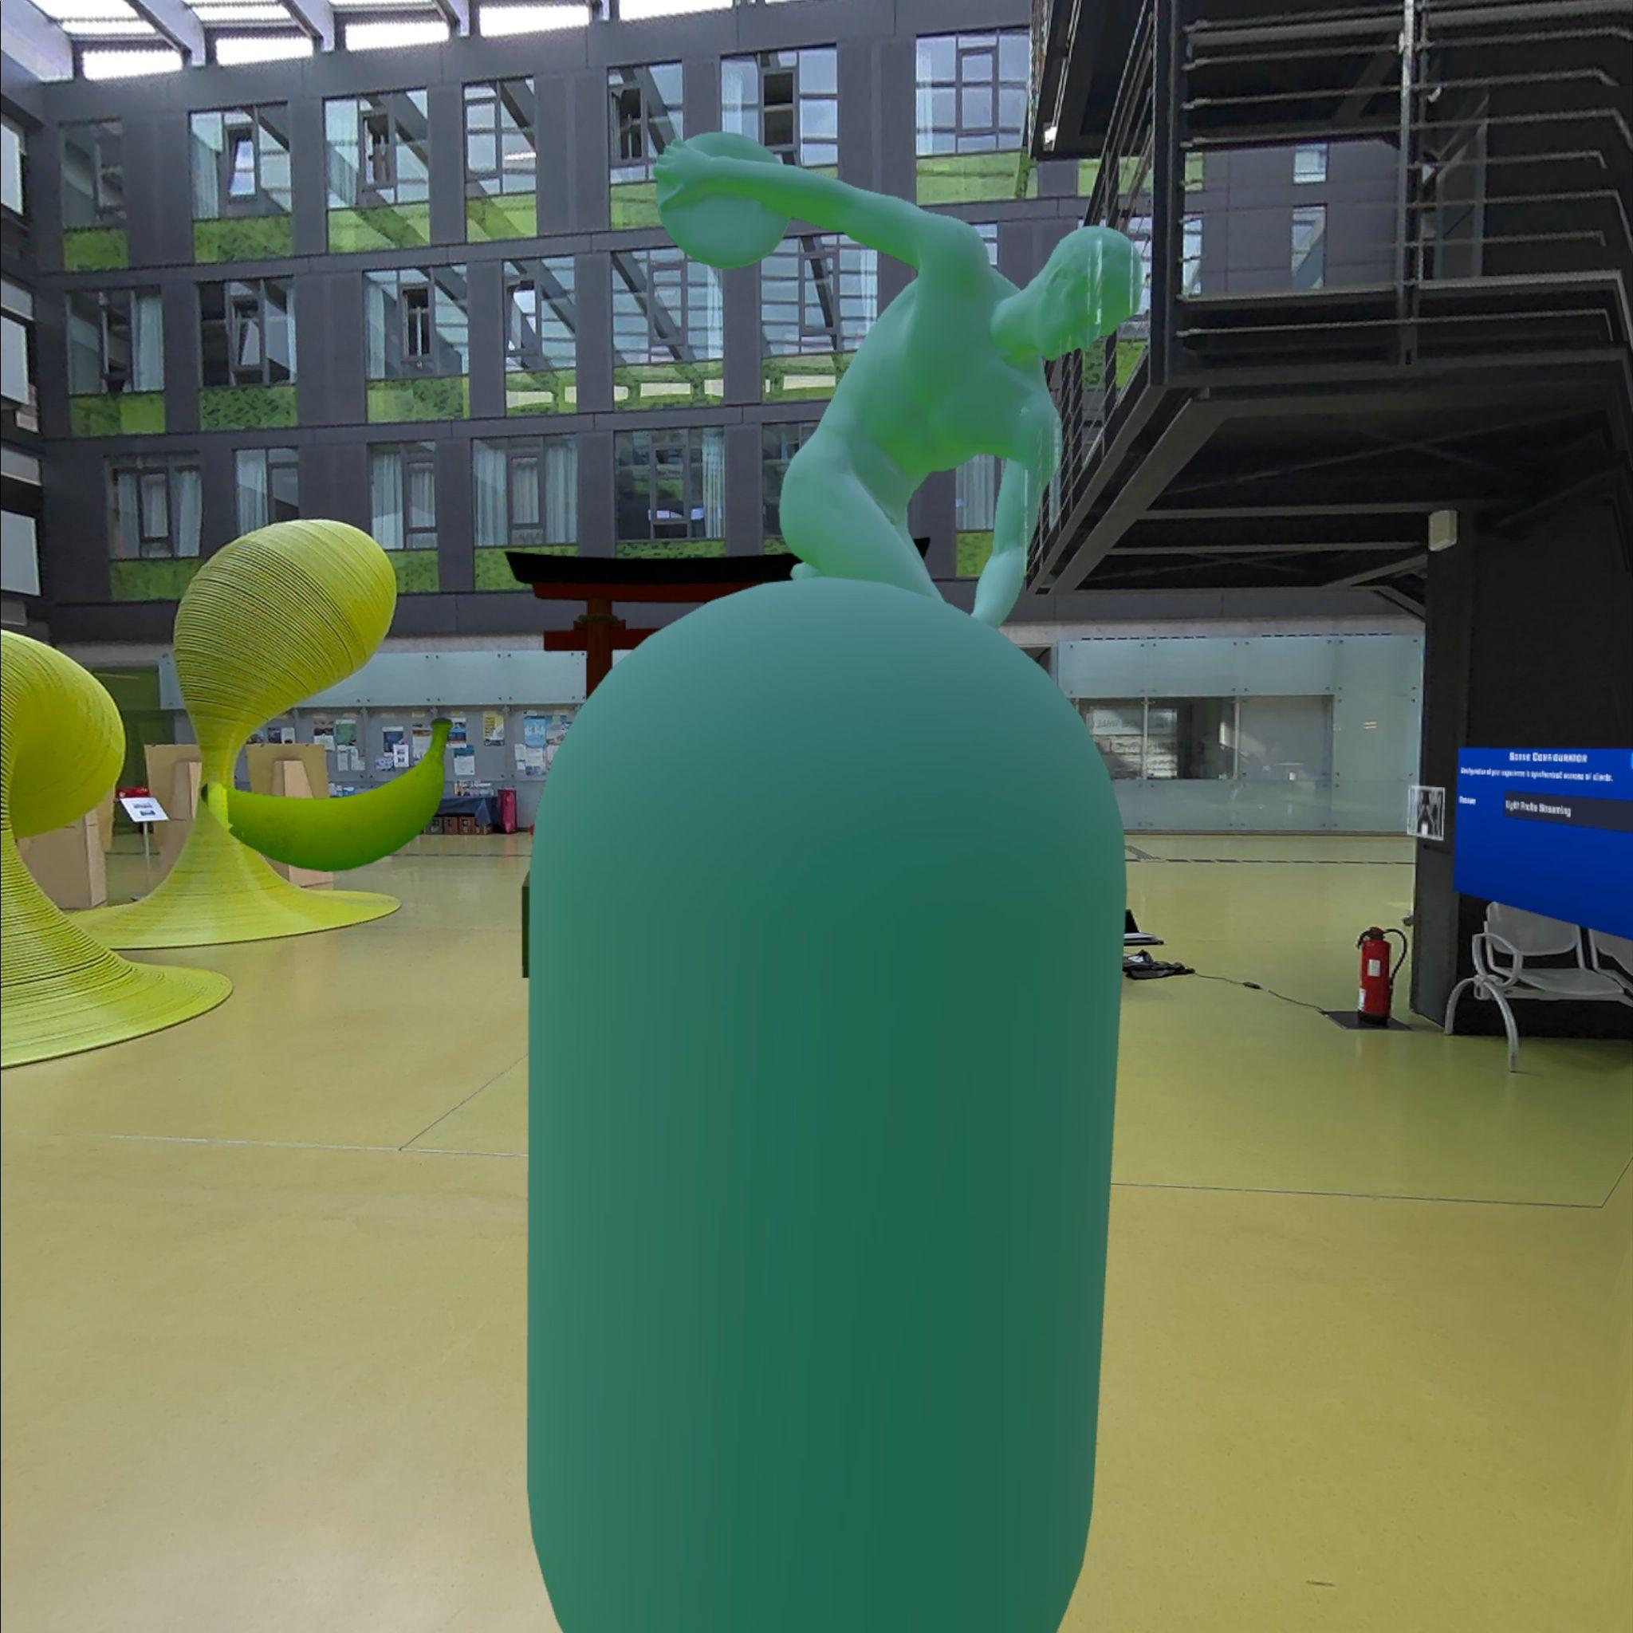
Further Challenges
Blue tint on the HMD

Slide 33
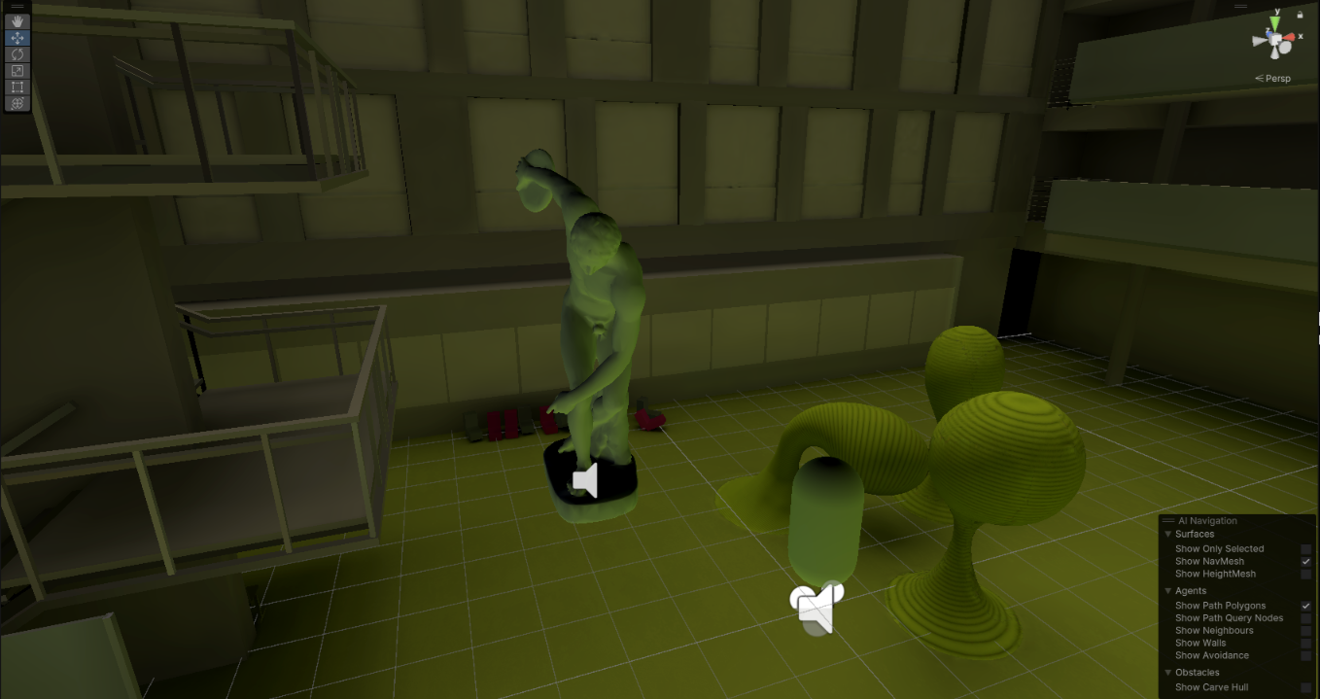
Blue tint on HMD
Initial guess was:
Cold color temperature of the camera
Too much influence of the blue sky
Effect only visible on computer,
On HMD still blue
(apparently) no tint when not lit from above

Slide 34
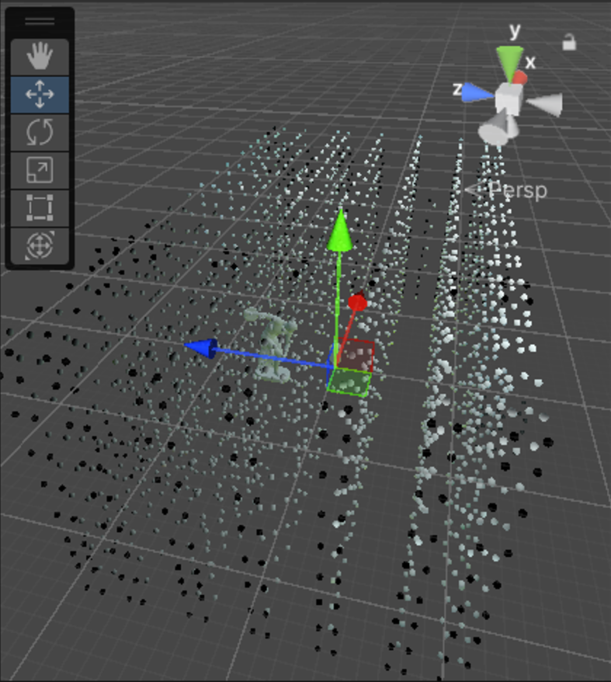
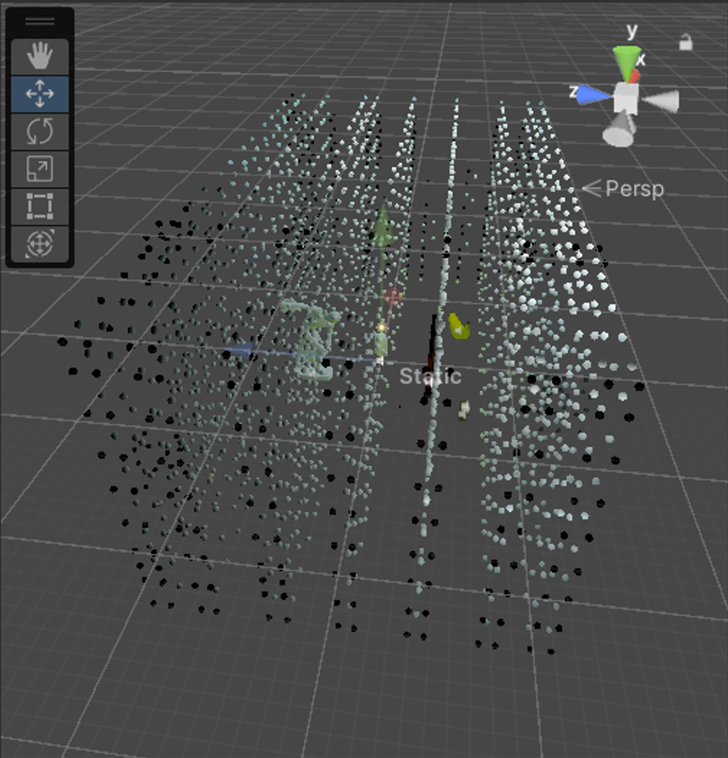
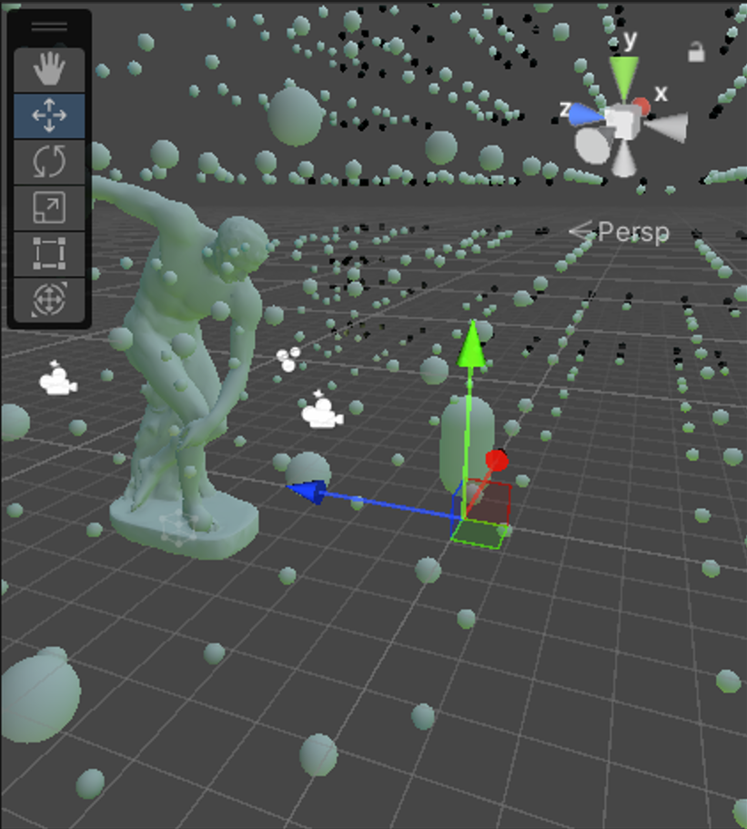
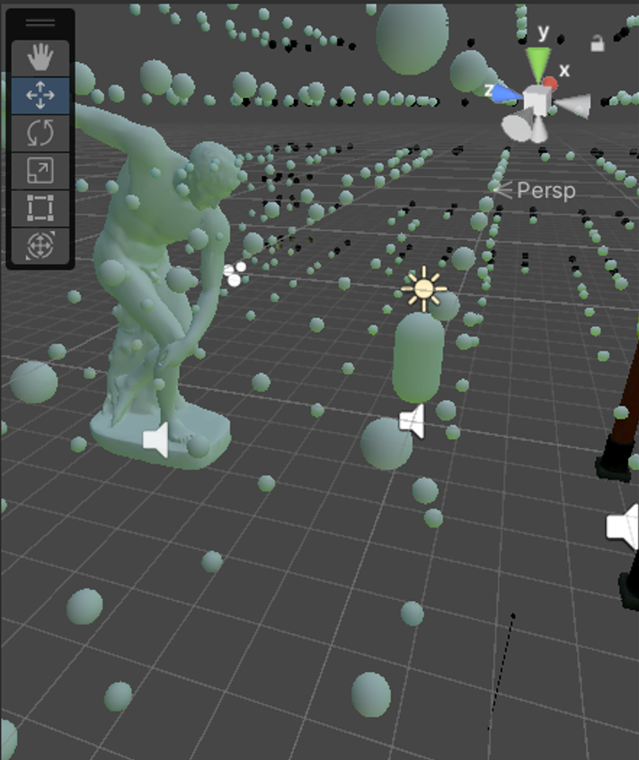
Blue tint on HMD
Server | Client
Next guess:
Error in transmission
Color channels swapped
Wrong Byte order
→ Diff checker on all coefficients
shows that transmission works
only 14 of 2359 light probes (0.6%) have discrepancies apart from rounding errors

Slide 35
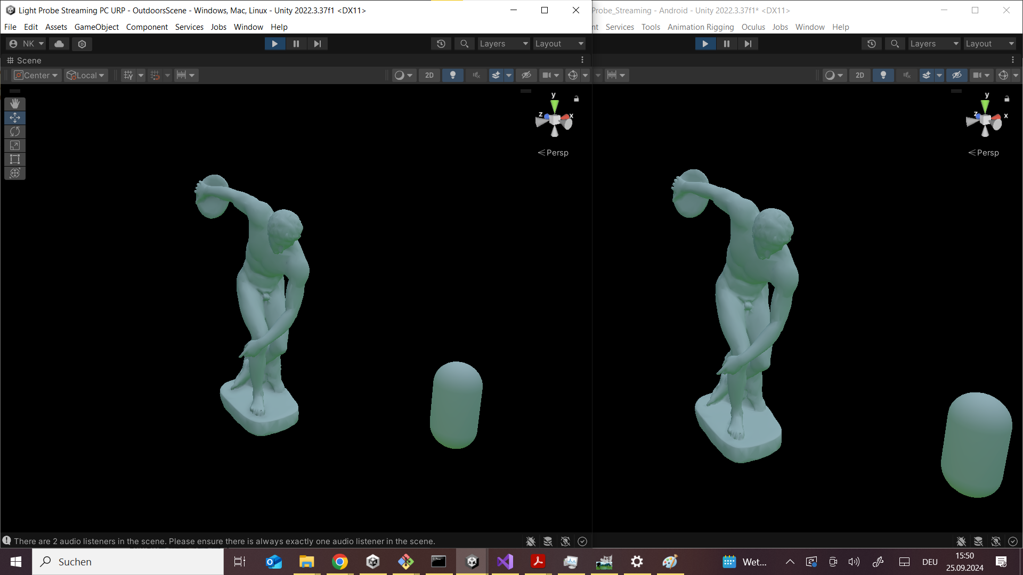





Blue tint on HMD
Next guess:
Display of the HMD
Color Settings
PC
HMD

Slide 36









Blue tint on HMD
Oculus Color Space Setting!
ViewR Preset
Unmanaged
Rec2020
Rec709
Rift CV1
PC Reference
Rift S
Quest 1
DCI P3
Adobe RGB

Slide 37


Results

Slide 38


Results: Spatial Differences

Slide 39



Results: Spatial Differences

Slide 40

Results: Camera Occlusion

Slide 41


Results: Artificial Sunset

Slide 42


Results: Artificial Red Blobs

Slide 43


Results Artificial Red Dot

Slide 44



Results: Skybox comparison
Model based
Skybox

Slide 45

Performance
Laptop | Desktop
i5-10210U 4 Cores / 8 Threads @ 1.6GHz - 4.2GHz GeForce MX250 | i7-13700K 8 P-Cores, 8 E-Cores / 16 Threads @ 2.5GHz - 5.4GHz GeForce GTX 1070
~ 10 FPS | ~ 30 - 50 FPS
~ 2s delay (1s camera, 1s lighting calculation) | -

Slide 46

Performance: Desktop PC

Slide 47


Further Considerations
not supported in URP
Light Probe Proxy Volume
without LPPV
with LPPV

Slide 48

Further Considerations
only available in
version 6 of Unity (preview)
Adaptive Probe Volumes
without APV
with APV

Slide 49

Further Considerations
A proper shader based projection & emission
→ less interpolation error
→ more flexible regarding repositioning of the camera
Sync interactable objects with rendering scene
→ virtual objects can interact with lighting
Place camera in the air + multiple cameras + HDR
→ reduce visual artifacts caused by humans
→ deal with obstruction
→ improve visual quality

Slide 50

Further Considerations
Compare to real objects

Slide 51
Conclusion
How can we get lighting information from the physical world to the MR application in real-time?
360° camera
Room model + emissive material
Streaming light probes over the network
+ works
+ is visually appealing
+ multi-user support (tested with 2 HMDs)
+ low requirements on the HMD
- FPS & delay could be improved
- can’t handle too dynamic environments
- setup process is cumbersome
→ works best for static setups with few concurrent users in a clear space
(e.g. exhibitions in museums)

Slide 52
Q&A
Any questions?

Slide 53
Image Sources
https://scontent.oculuscdn.com/v/t64.5771-25/38974492_442085696619485_5665262356792344576_n.png?_nc_cat=107&ccb=1-7&_nc_sid=6e7a0a&_nc_ohc=T7N4iK_mO3UQ7kNvgGuZRQ7&_nc_ht=scontent.oculuscdn.com&oh=00_AYBQq080owE6bwtX055LFf7dWuuPNmJXHl-lRWaM_-OYsw&oe=66F8932B (slide 4)
https://mixed-news.com/en/wp-content/uploads/2022/10/Demeo_Mixed_Reality-860x484.png (slide 4)
https://i.imgur.com/Fwmkpn0.png (slide 6)
https://www.az-delivery.de/cdn/shop/products/tcs34725-rgb-farb-sensor-mit-infrarot-filter-diy-modul-zur-farb-erkennung-kompatibel-mit-arduino-414913.jpg?v=1679399266&width=1200 (slide 10)
https://cdn1.botland.de/123834-pdt_540/sparkfun-tristimulus-farbsensor-opt4048dtsr-qwiic-sparkfun-sen-22638.jpg (slide 10)
https://de.farnell.com/productimages/standard/en_GB/3879713-40.jpg (slide 10)
https://m.media-amazon.com/images/I/61o2ZUzB4XL._AC_UF894,1000_QL80_.jpg (slide 10)
https://encrypted-tbn0.gstatic.com/images?q=tbn:ANd9GcRAwg2N3x8ThZIaaJbuxyon9qF6mDl_pNxI_A&s (slide 15, 16)
https://ricohtheta.eu/cdn/shop/products/Theta-Z1-front-screen-on.jpg?v=1655989855 (slide 15, 17, 18)
https://vr-expert.de/wp-content/webp-express/webp-images/uploads/2023/08/Quest-3-diagnal-view.png.webp (slide 15, 16)
https://haid-computers.de/cdn/shop/products/rgb_gaming_pc_talius_adf23630-328c-49ea-bc12-b6bf1bf5dc38_600x.png?v=1659005283 (slide 15, 16)
https://heise.cloudimg.io/bound/1200x1200/q85.png-lossy-85.webp-lossy-85.foil1/_www-heise-de_/imgs/18/3/0/8/8/9/3/9/Bildschirmfoto_2021-04-15_um_13-427ab236292eb0de.png (slide 17)
https://docs.unity3d.com/uploads/GlobalIllumination/EmissiveMaterial.png (slide 22)
https://docs.unity3d.com/uploads/Main/LightProbeProxyVolumeExample2.png (slide 47)
https://docs.unity3d.com/uploads/Main/LightProbeProxyVolumeExample1.png (slide 47)
https://docs.unity3d.com/6000.0/Documentation/uploads/urp/probe-volumes/probevolumes-per-pixel.jpg (slide 48)

Slide 54

Backup Slides
14 incorrect light probes

Slide 55

Backup Slides
Memory Management
→ SWAP used 30GB of disk space
→ degraded performance of whole system

Slide 56
Backup Slides
Unity deleted all my Light Probes when saving the scene
→ had to manually edit .unity file to get them back
→ a bug in Unity?

